Slide 1

PROJECT
WILDLIFE GUARDIAN
TEAM:
FFF ( FIGHT FOR FUN )

Slide 2

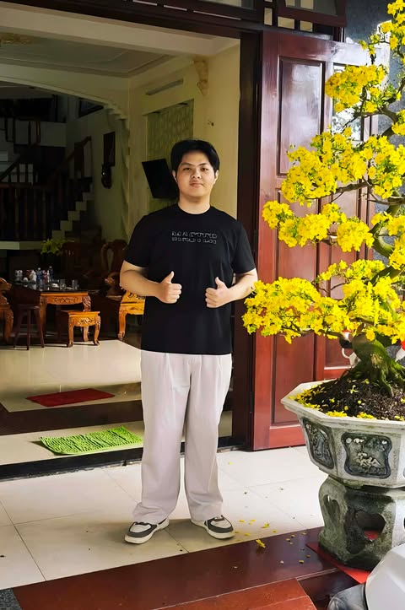
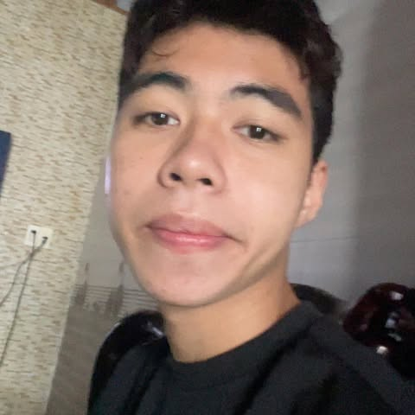

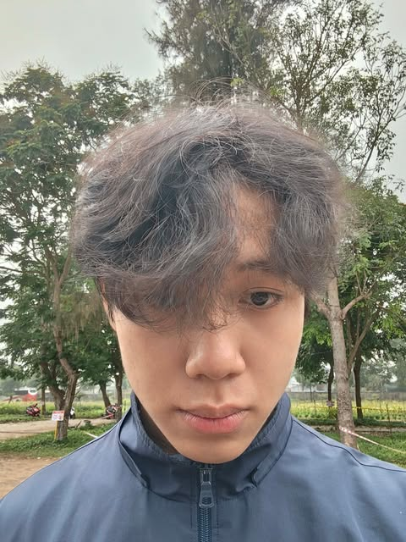
TEAM MEMBER
TEAM:
FFF ( FIGHT FOR FUN )
Trương Văn Tuấn
Võ Nguyễn Thái Bảo
Nguyễn Thanh Hưng
Nguyễn Danh Thái
25IT223
25IT016
25IT071
25IT178

Slide 3

WILDLIFE GUARDIAN
FFF ( FIGHT FOR FUN )
1. REASONS FOR CHOOSING THE TOPIC
In the context of rapid globalization and industrialization, biodiversity worldwide is facing an unprecedented and severe decline.
The issues of illegal hunting, illicit trade, and the shrinking of natural wildlife habitats are no longer just a problem for individual countries, but have become an ecological crisis on a global scale.
Reality
Current traditional methods of wildlife education are often dry.
Global users, especially digital citizens (Gen Z, Gen Alpha), find it difficult to feel connected to nature through purely text-based articles.
Solution
From these gaps, the challenge posed is the need for a digital platform capable of conveying conservation messages vividly and intuitively, while connecting the global .
That is the reason for the "Wildlife Guardian" project.

Slide 4
EDIT NAME PROJECT HERE...
EDIT TEAM NAME HERE
2. PRODUCTION INTRODUCTION
Interactive Rescue Map include : emergency report , real-time 3D Map , condition classification
Social NetWork : sharing platform , multi-dimensional interaction , direct message
Species Library & Game : encyclopedia , gamification
Phoneix AI : google gemini integration , 24/7 animal expert
Featured UI/UX : dark nature theme & glassmorphism , parallax effect & the universe

Slide 5
EDIT NAME PROJECT HERE...
EDIT TEAM NAME HERE
3. TECHNOLOGIES USED
FRONTEND : core languages as HTML , CSS , JAVASCRIPT , 3D Mapping & GIS , UI/UX , Graphics & Animations
BACKEND : Node.js , Web Framework
DATABASE & CLOUD STORAGE : MongoDB , Cloudinary
ARTIFICIAL INTELLIGENCE (AI ) : Google Gemini Api

Slide 6
EDIT NAME PROJECT HERE...
EDIT TEAM NAME HERE
4. PHÂN TÍCH THIẾT KẾ HỆ THỐNG (nếu có -không có có thể xoá slide này)

Slide 7
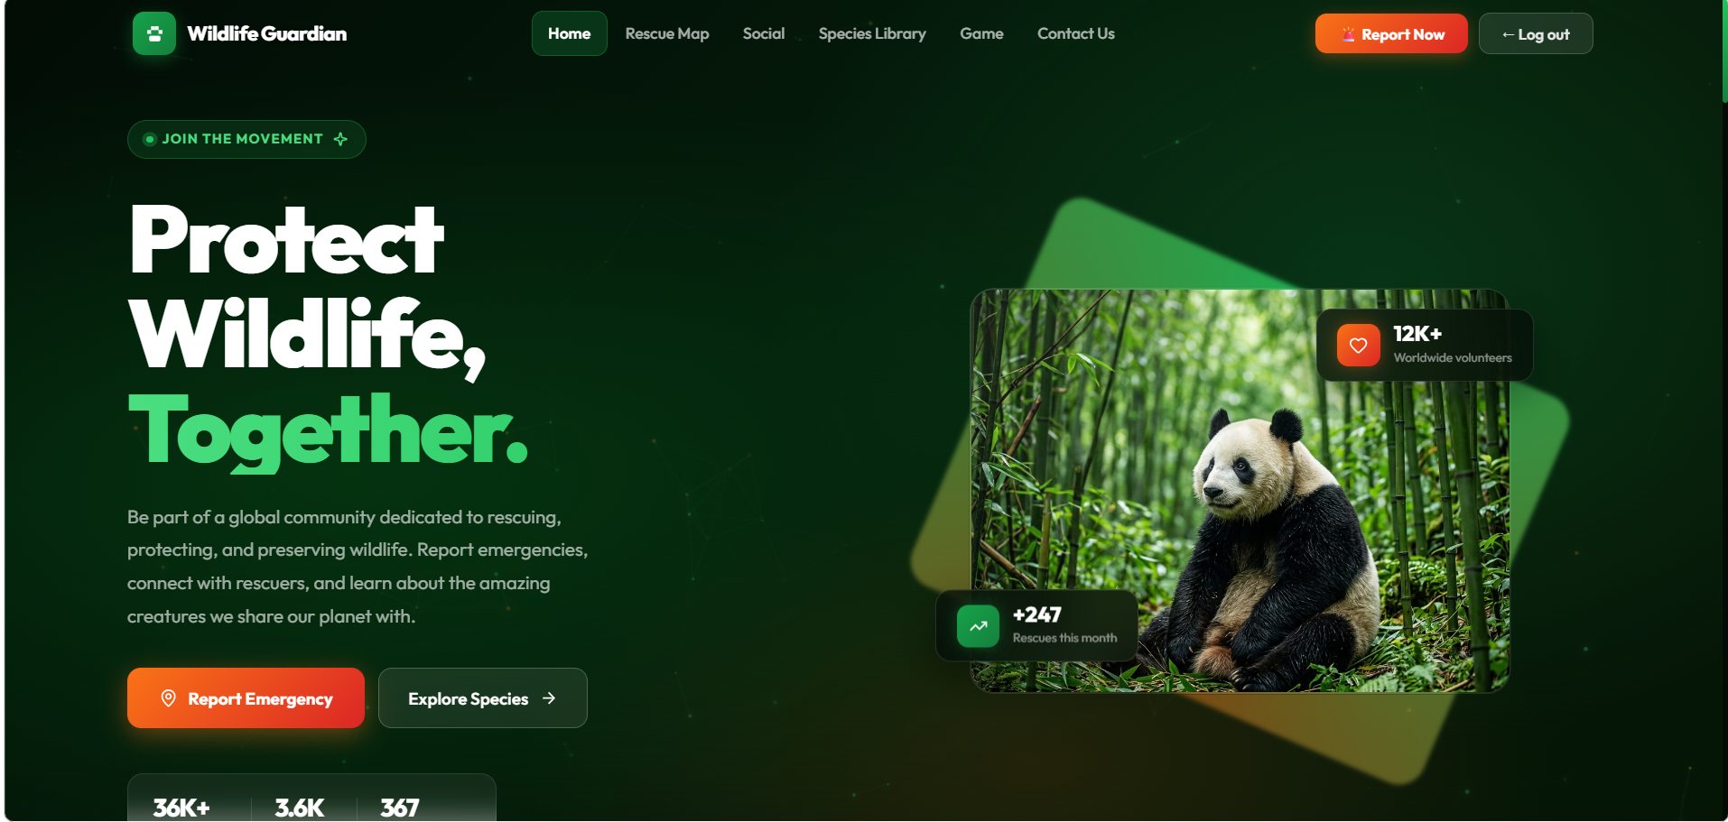
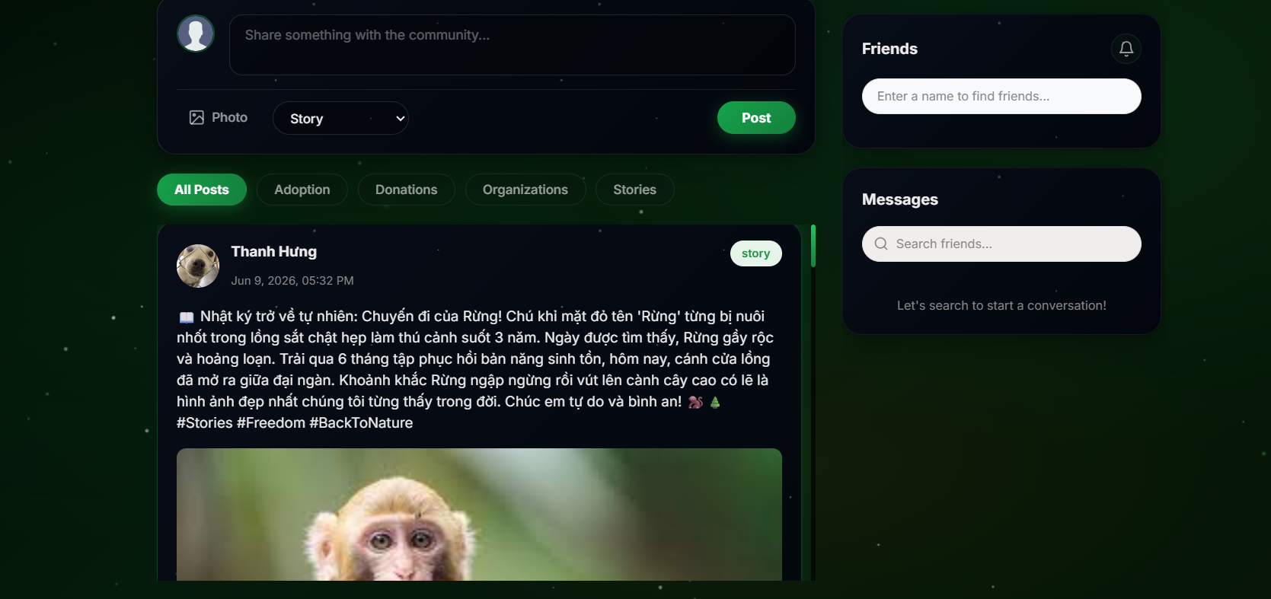
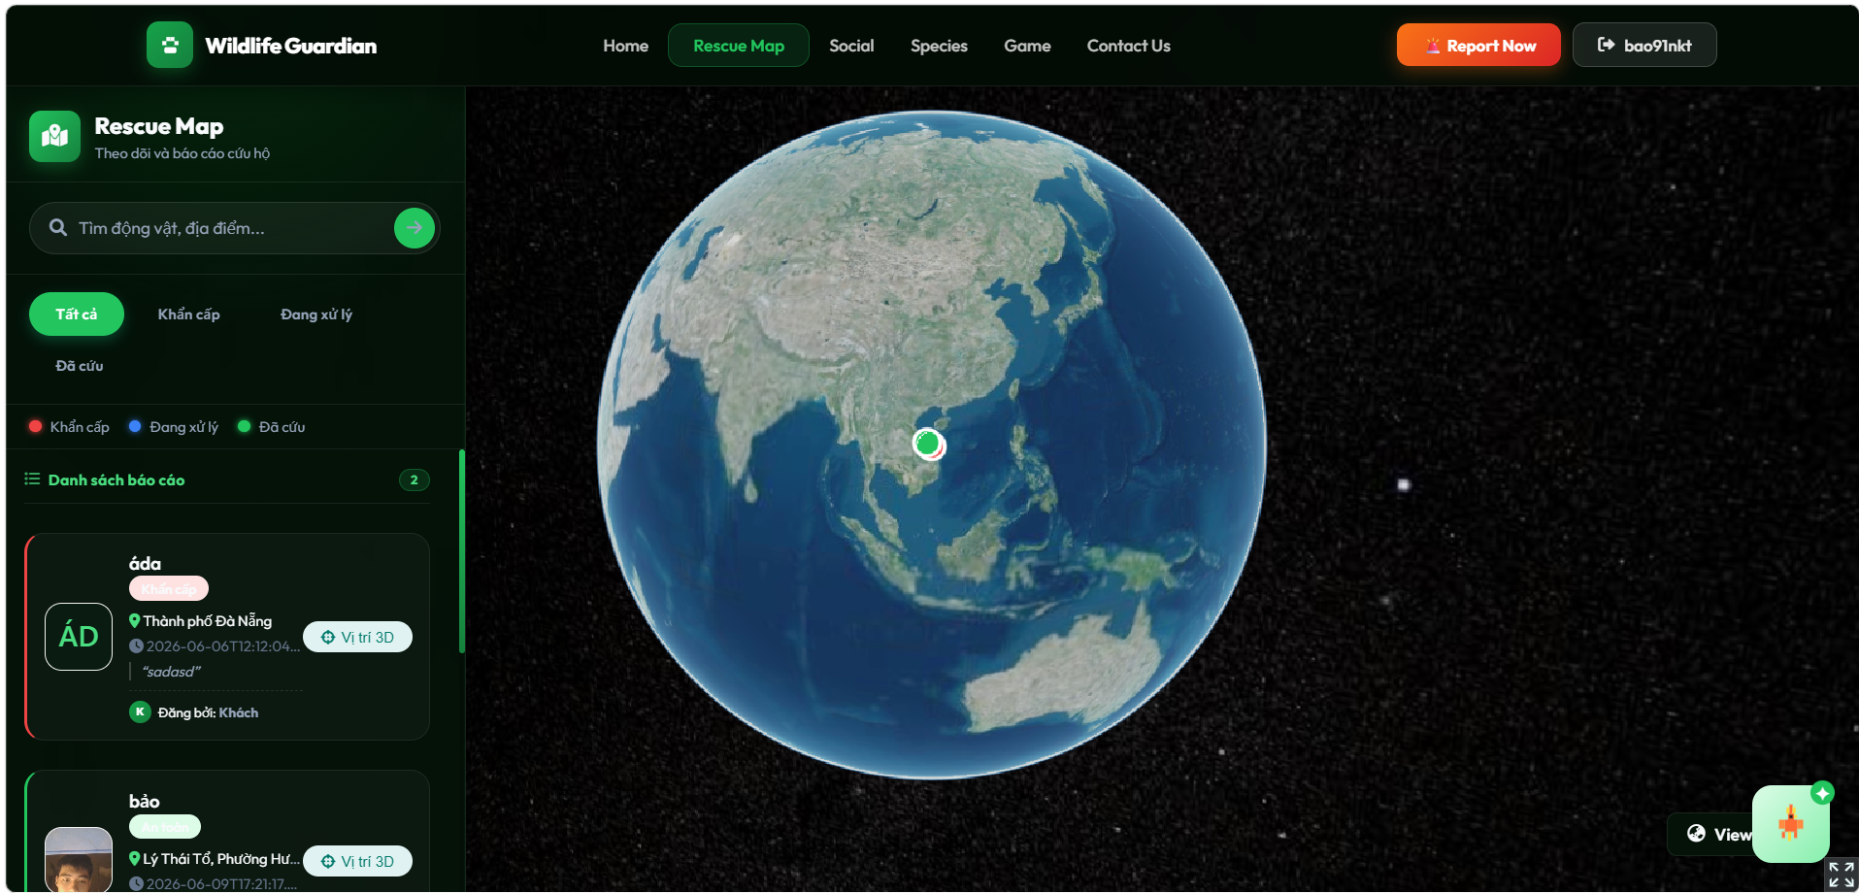
EDIT NAME PROJECT HERE...
EDIT TEAM NAME HERE
5. DEMO SẢN PHẨM
Đường dẫn website để tại đây

Slide 8
THANK YOU ......

